Slide 1
Child and Adult Care Food Program

Slide 2
Purpose of the CACFP
Assist Childcare centers, day care homes, head starts, at risk after school programs, emergency shelters, and adult day care centers in providing nutritious meals to their participants through reimbursement for provision of healthy meals.

Slide 3
CACFP Funding and Regulatory Authority
National School Lunch Act
Child Nutrition Reauthorization
United States Department of Agriculture (USDA) – Food and Nutrition Services (FNS)
Regulated by 7 CFR part 226
Administered by the Kentucky Department of Education

Slide 4
Eligible Site Types
Child Care Center
At-Risk After School Program
Emergency Shelter/Homeless Shelter
Head Start and State Funded Preschool
Adult Day Care Center
Family Day Care Home

Slide 5
Child Care Centers
Age 12 years and under or children of migrant workers 15 and under; or mentally/physically disabled persons under 18 yrs.
Meal reimbursement rates are determined by income
May serve 2 meals and a snack per day.
For Profit - 25% of the children must be eligible for free or reduced-price meals.
This is not a requirement for non-profits.

Slide 6
At-Risk After School Program
Must provide enrichment activities afterschool or on weekends, holidays, or school vacations during the regular school year.
Must be located in the attendance area of a school where at least fifty percent of the children are eligible for free or reduced-price meals based on the National School Lunch Program Qualifying Data.
Serve children up to the age of 18 yrs.
May serve one meal and one snack per day.
All meals are reimbursed at the free rate.

Slide 7
Emergency Shelter/Homeless Shelter
Children through age 18.
May serve up to three meals per day
All meals are reimbursed at the free rate.

Slide 8
Head Start and State Funded Preschool
Federal or State funded centers.
May serve 2 meals and a snack per day.
Head Starts - All meals are reimbursed at the free rate.
State Funded Preschools are reimbursed based on household income.

Slide 9
Adult Day Care Centers
Serve adults over 60 years and adults over 18 years who are disabled.
Under 60 years of age must have a care plan.
Meals are reimbursed at the rate determined by household income.
May serve two meals and one snack per day.

Slide 10
Family Day Care Home
Age 12 years and under or children of migrant workers 15 and under; or mentally/physically disabled persons under 18 yrs.
Two meals and one snack can be served.
Meal rates are determined by Tiers.

Slide 11
Options for Participation
A sponsor may participate under a State Agency approved and participating sponsoring organization (SO).
A sponsor may apply directly with the State Agency.
All centers that inquire are given both options with the exception of family day care homes. Family day care homes are required by 7 CFR 226.18(b) to participate with an SO.

Slide 12
Sponsoring Organization Participation
The SO provides training, technical assistance, monitoring and filing of claims for the center.
  A SO for centers may take up to 15% of the reimbursement for administrative expenses.
  For Day Care Homes, the SO receives a separate administrative allowance.

Slide 13
Requirements for Applying as a Sponsor
Submit financial records to prove financial viability. 7 CFR 226.6(b)(1)(xviii)(A)
  Financial records for the previous three months are requested and reviewed
  A budget is submitted.
  Must demonstrate need for service.
Prove Administrative Capability and Program Accountability per 7 CFR 226.6(b)(1)(xviii)(B) and (C)
  Provide documentation that shows an adequate plan for operation including staffing and policies and procedures.

Slide 14
CACFP Centers Served: Federal Fiscal Year 2022
Total Number of Sites – 1,885
  Adult Day Care – 92
  At-Risk Afterschool Program – 613
  Child Care Centers – 726
  Emergency Shelters – 13
  Head Starts -236
  Day Care Homes - 205

Slide 15
Average Daily Attendance: FFY22
Total 73,896
  1,856 Adult Day Cares
  34,080 At Risk After School Programs
  31,064 Child Cares
  6,702 Head Starts
  194 Emergency Shelters

Slide 16
Other FY22 Data:
23,327,960 meals per year
$41 Million in Reimbursement

Slide 17
Funding
Approved sponsors file an electronic claim for reimbursement for creditable meals served.
The state agency receives the electronic claim and processes payments to the sponsor.

Slide 18
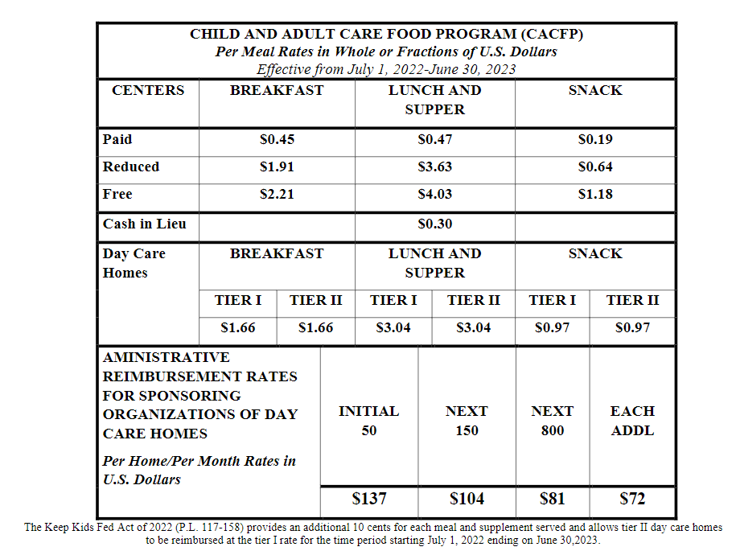

Slide 19
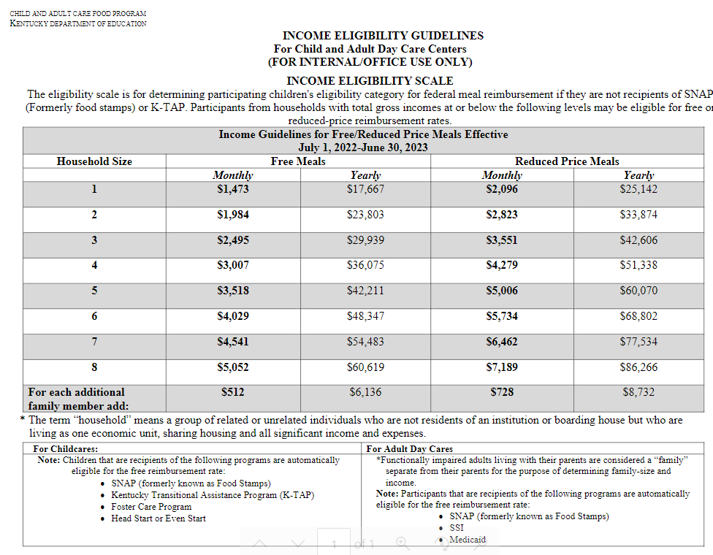

Slide 20
Record Keeping Requirements
Documentation to support claims must be kept on file.
Retention is required for the current year plus the three prior years.

Slide 21
Nutrition Requirements
Aligns with WIC, the Dietary Guidelines for Americans, and the American Academy of Pediatrics Recommendations.

Slide 22
Meal Patterns

Slide 23
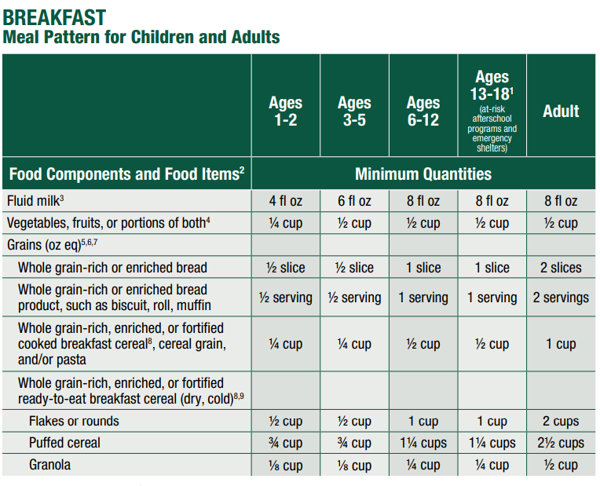

Slide 24
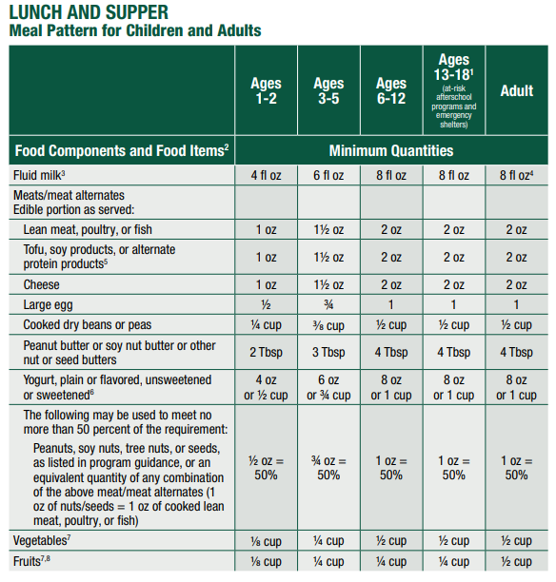

Slide 25
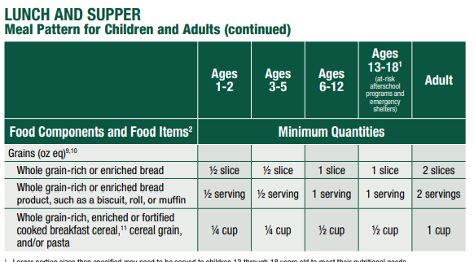

Slide 26
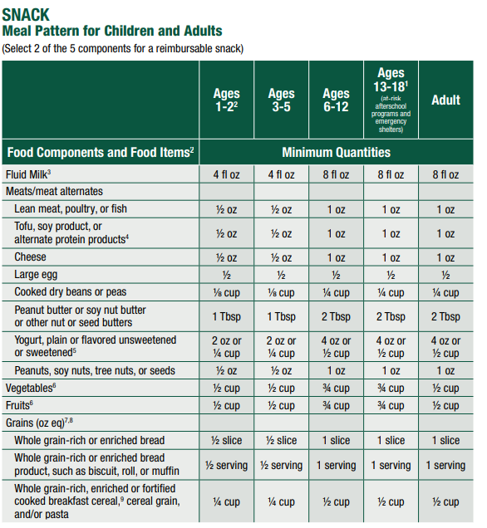

Slide 27
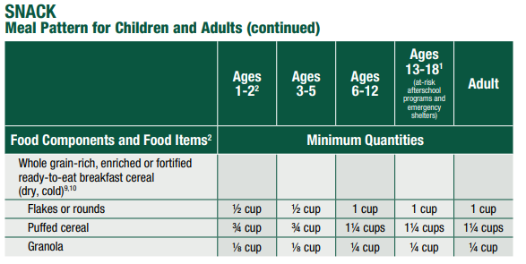

Slide 28
Questions
Elizabeth Fiehler
Child and Adult Care Food Program Manager
Elizabeth.Fiehler@education.ky.gov

